Slide 1
WHERE ARE YOU FROM? Local, regional, national and international festivals and celebrations,
part of a project on the Venetian Region
by the “Anne Frank” Primary School Fifth Graders, sections A-B
from Noventa Padovana, Padua
English teacher - Ms Pelizzaro
school year 2016/17
Referente del progetto interdisciplinare “Ma tu di che regione sei?” Mrs Santoro.
Other class teachers - Miss Pagnin, Mrs Zamboni,
Mrs Tessari, Ms Faggian, Ms Barina, Miss Surace.

Slide 2
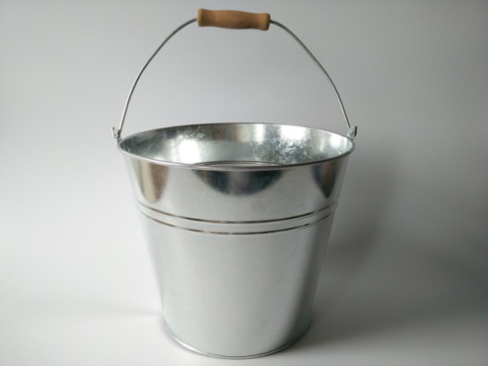
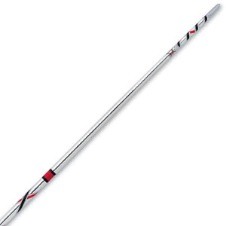
BATIMARSO Batimarso is a Venetian celebration. It is on the 1st of March. It’s done for the awakening of nature. People go on a procession down the streets, hitting metal buckets or pots with a stick. BY THE GROUP WORK ALBERTO, ANDREA AND SOFIA

Slide 3
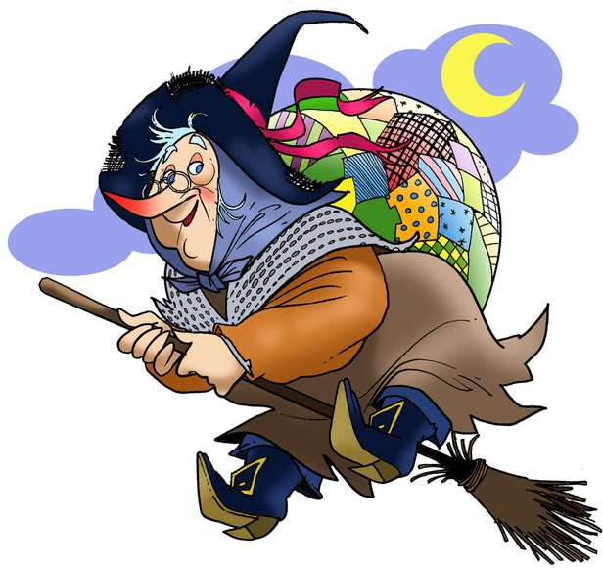
BEFANA DAY The 6th January, is Befana Day. For the celebration there’s special food to eat: fake sweet coal cakes and candy, onions and ashes for naughty kids. These foods are placed in the stockings, in shoes or both. The stockings are gift packs! The Befana has got no teeth. She is an old woman and she has got a long nose too. But the Befana is not a witch! She wears a long skirt, heavy socks and comfortable shoes. She has got a whole broom to fly with or just a stick. She isn't a bad woman though! Mustafa and Ramisa

Slide 4
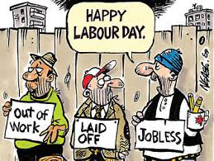
May 1st In the middle of the 19th century the workers had no rights: they even worked 16 hours a day, in awful conditions and they often died on the work place. On 1st May 1886 it was called a general strike in the whole United States in order to cut down the working day to 8 hours. The protest culminated with a real battle, the Hay Market massacre, in which 11 people died. In 1889 in Paris, during the Congress of the II Internationale, it was launched the idea that on 1st May there could be a demostration and this could become a national festivity in many countries like Cuba, Russia, China, Mexico, Brasil, Turkey and UE Countries, but not in the USA. In Italy it was repealed by Fascism and officially it became a national festivity in 1947. Zhou YuJie and Alessandro Turchetto

Slide 5
VENICE CARNIVAL The first Carnival was in Venice, a famous city in the Venetian region, in the North-East of Italy. It was invented in 1094 under the doge Vitale Falier. The Carnival is a fun festival and it is beautiful. It begins on 7th January and it finishes in February. There are special foods like “fritole” and “castagnole” (sweet fried dumplings) and other cakes. We wear costumes and masks.
Emma, Jesser and Giulia

Slide 6
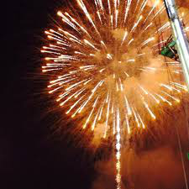
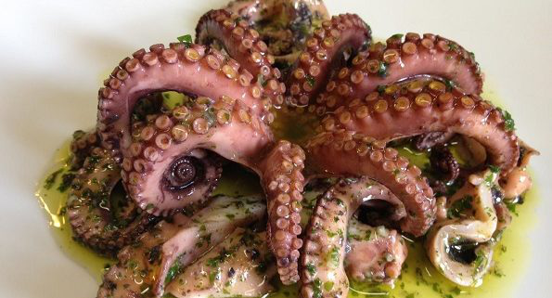
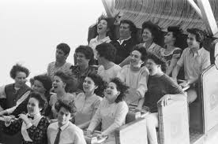
The Octopus Fair The Octopus Fair is a country fair. It is celebrated here in Noventa Padovana. It’s from 21st to 25th October. We eat fish and drink wine. There are carnival rides and clothes/food stalls. The end of it it’s on Tuesday, when there are fireworks at midnight. Sergiu, Giacomo and Samuele

Slide 7
EASTER IN ITALY In 325 A.D. Christians celebrated the Resurrection of the Lord Jesus Christ , according to the Gospels. The name of the celebration was first “Pass-over”(BIBLE ) and now Easter . For Easter, Italian children receive presents, usually a chocolate egg. Easter is an important celebration for Christians all over the world. Lent is a period of forty days before Easter, when Christians don’t eat meat or fish on Fridays . Maria and Mattia

Slide 8
REDENTORE’S DAY Redentore’s Day is a traditional festival in Venice . The celebration is on the Saturday before the 3rd Sunday of July. There are fireworks for everyone to see. It was born in 4th September 1576. There was a terrible plague in Venice. The Venetians started to pray the Holy Mary for help. They built a boat –bridge, connecting the Church of the Holy Spirit with the Church of Christ, the Redeemer (Redentore). It’s here that the celebration takes place. Daniele, Sofia and Noemi

Slide 9
THE CARNIVAL OF STRA Sunday 5th March 2017, there was a special Carnival at Villa Pisani of Stra. There were many activities to do: -shopping -inflatable games -boat- riding -a mask-parade -buskers… The Carnival is before Lent. There are many celebrations in costumes with masks, parades and dances. It ends on “Fat Tuesday”. The name “carnival” comes from the Latin word “carne- vale” which means “remove meats”. In the past the masks were used to scare the evil spirits. Laura and Sofia

Slide 10
The Festival of Saint Martin’s is a special celebration particularly in Piove di Sacco, a small Venetian town. There is a lot of food and lots of people. They eat typical autumn food as roasted chestnuts. The festival is on 29th October. Saint Martin is the Patron Saint of this small town. Martina and Chiara

Slide 11
THE OCTUPUS FAIR On the fourth week of October the Festival of the Octupus gets started. At the festival of the Octupus, we can eat the octupus,”frittelle” (sweet fried-doughnuts), chestnuts, cakes and peanuts. The Festival is very old. It was born in Noventa Padovana, where we live. There are lots of foods and clothes-stands. People have fun. It’s very nice! At midnight there are fireworks too. Jessica, Alberto and Leonardo

Slide 12
THE CARNIVAL OF VENICE It was born on the eleventh century. It was on the 7th of January. People only thought about partying during the celebration. They held parades on the streets. They used colorful masks and clothes. The celebration takes place every year to this day. Alessia, Francesco and Leonardo

Slide 13
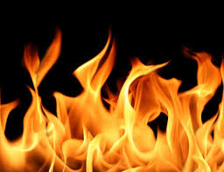
“BRUSA LA VECIA" “Brusa la vecia” is the Venetian dialect for “the burning of the old woman” ( the Befana). It’s a celebration in Verona, where the party is for the Epiphany. The party takes place in “Bra Square”, downtown. The tradition starts after Christmas, on 6th January. It was born in 1616. The old woman is made of old clothes and hay. She is then burnt on a bonfire. Afterwards there’s a feast with meat and fish. BADR, FEDERICO AND MARCO

Slide 14
THE CARNIVAL OF VERONA The Carnival of Verona goes from the 24th to 25th of February. It’s famous, beautiful and very fun! There is a special man called “Papà del Gnoco”, which means “The Dumpling’s Dad ”. He has got a white beard, a red mantle and a big fork with a dumpling on it. Each year the man is different. The Dumpling’s Dad starts the celebration. Afterwords there’s a parade with masks food and drinks. Matilde, Erica and Juliana

Slide 15
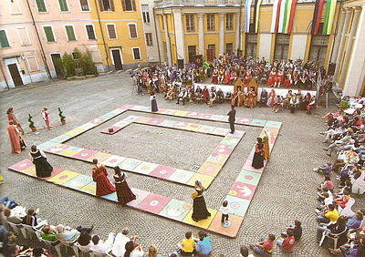
THE GOOSE FAIR OF MIRANO (VENICE) The Goose Fair is a celebration. It was born in the eighties but there's an a old tradition under it. It's Saint Martin's day, on 11th November. It's the time when the locals eat goose for lunch, Saint Martin's goose with chestnuts and drinks. In the main square of Mirano, a small town near Venice, people play a gigantic “SCALES AND LADDERS” game, with real persons and animals. Who wins the game takes home the real goose to eat. Elena, Greta and Jasmine

Slide 16
THE END
THE END

